Slide 1

NaijaStream Business Insights Executive summary of analysis, KPIs, and recommendations
Efeomo Blessing Asekhame

Slide 2
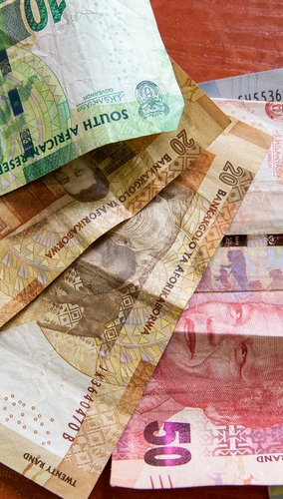
Project Overview
Analyzed NaijaStream subscription dataset (2,000 records).
Built an Excel dashboard after cleaning data, calculating KPIs, creating pivot tables and charts.
Focus areas: revenue (MRR/ARR/ARPU), churn & retention, device usage, regional performance.
This Photo by Unknown Author is licensed under CC BY-ND

Slide 3

Business Objectives
Quantify recurring revenue and average revenue per user.
Identify which subscription tiers and regions drive revenue.
Measure churn and retention by tier.
Recommend targeted actions to grow revenue and reduce churn.

Slide 4

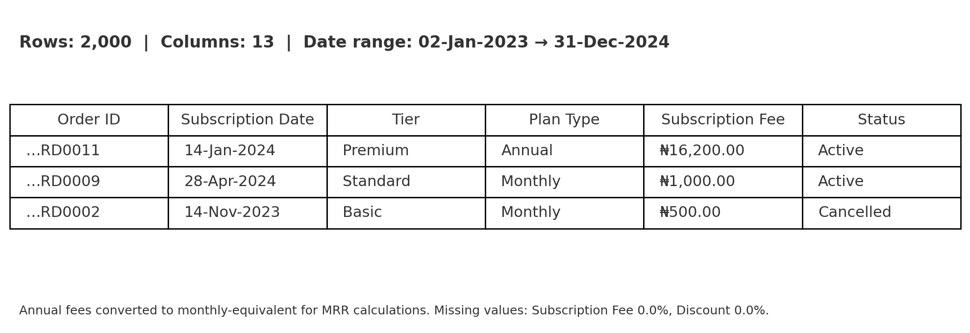
Dataset Summary
Records analyzed: 2,000 subscriptions.
Key fields used: Order ID, Subscription Date, Tier, Plan Type (monthly/annual), Subscription Fee, Region, State, Device, Status, Churn Flag.
Mixed monthly & annual plans — normalized to monthly and annual equivalents for fair comparison.

Slide 5





Key Metrics Defined
MRR (Monthly Recurring Revenue):
Sum of monthly-equivalent subscription amounts.
ARR (Annual Recurring Revenue):
MRR × 12 (or sum of annual equivalents).
ARPU (Average Revenue Per User):
MRR / total users (monthly) and ARR / total users (annual).
Churn Rate:
% of subscriptions cancelled / churn-flagged.
Dashboard calculations included:
Total revenue & orders; MRR & ARR; ARPU (monthly & annual); churn count & overall churn rate; average monthly-equivalent revenue by tier and churn vs retention by tier; MRR/ARR by region/state; device share (overall & active); and monthly MRR trend (highest/lowest months).

Slide 6
Overall KPIs (from the dataset)
Total recorded revenue
(sum of Subscription Fee): ₦12,099,800.00
ARR
(annual-equivalent): ₦12,089,400.00
Churn rate (overall): ~49%
MRR
(monthly-equivalent): ₦1,007,450.00
ARPU
(monthly): ₦503.73—(annual): ₦6,044.80

Slide 7
Revenue by Subscription Tier
Premium
Standard and Basic.
Tier pricing
generates the highest average monthly revenue per user.
contribute lower ARPU — higher volumes but less revenue per user
is the primary driver of revenue differences.

Slide 8
Tier | Total | Churned | Churn Rate (%)
Premium | 653 | 336 | 51.45
Basic | 701 | 327 | 46.66
Standard | 646 | 296 | 45.82

Slide 9
Churn vs Retention by Tier
Churn and retention evaluated per tier (counts and %).
Identify which tier has the highest churn.
High-churn tiers are priority for retention programs (offers, onboarding, customer success).

Slide 10
Regional Revenue Distribution
MRR and ARR broken down by Region (top contributors shown).
Regions with highest recurring revenue should be prioritized for marketing + partnerships.
Regions with low revenue but high user counts are candidates for conversion-focused campaigns.

Slide 11
Device Usage Analysis
Device share among active users (e.g., Mobile is largest share — insert exact %).
Device mix indicates product optimization priorities (mobile-first vs desktop).
Device-targeted campaigns (push notifications, in-app offers) recommended for high-share devices.

Slide 12

Recommendations & Next Steps
Localize Growth Campaigns in High-Revenue States & Regions
-Focus marketing in Lagos, Enugu, Kano
-Prioritize West, North, East Nigeria (₦4.34M revenue)
Reduce Churn in Monthly & Premium Plans
-Introduce loyalty perks & early access
-Deploy win-back campaigns for monthly users
Upsell Basic Subscribers into Higher Tiers
-Basic ARPU ₦2,750 (48% below avg.)
-Offer upgrade bundles & family sharing
Prioritize Mobile User Experience & Engagement
-47.8% stream via mobile
-Enhance UI/UX, offline viewing, and data optimization

Slide 13

Summary
NaijaStream’s growth relies on regional targeting, churn management, tier upgrades, and mobile optimization. By focusing on high-revenue states, retaining premium and monthly users, upselling Basic subscribers, and enhancing the mobile experience, the platform can boost revenue, reduce churn, and strengthen customer loyalty.

Slide 14

Thank you
Efeomo Blessing Asekhame
asekhameefeomo@yahoo.com

